Slide 1


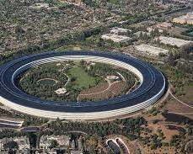
Customer Sentimental Analysis
Apple I phone 15 128 GB Model

Slide 2

"We're very simple people at Apple. We focus on making the world's best products and enriching people's lives."
* **Founding:** Apple Inc. was founded on April 1, 1976, by Steve Jobs, Steve Wozniak, and Ronald Wayne.
* **Headquarters:** Its headquarters are located at Apple Park in Cupertino, California, USA.
* **Key Products:** Apple is renowned for its consumer electronics, software, and online services, including the iPhone, Mac, iPad, Apple Watch, Apple TV, iOS, macOS, watches', iCloud, Apple Music, and the App Store.
* **Market Dominance:** The iPhone is consistently one of the best-selling smartphones globally, contributing a significant portion of Apple's revenue.
* **Revenue Leader:** Apple is one of the world's largest technology companies by revenue and one of the most valuable companies globally by market capitalization.
* **Retail Presence:** Apple operates a vast network of retail stores worldwide, known for their distinctive design and customer service.
* **Emphasis on Design & User Experience:** The company is famous for its strong focus on product design, ease of use, and integrated hardware and software experience.
* **Ecosystem Approach:** Apple creates a tightly integrated ecosystem across its devices and services, aiming to provide a seamless user experience.
* **Sustainability Efforts:** Apple has made significant commitments and progress towards environmental sustainability, aiming for carbon neutrality across its supply chain and products.
* **Innovation:** The company has a history of innovation that has disrupted various industries, from personal computing to music players and mobile phones.

Slide 3

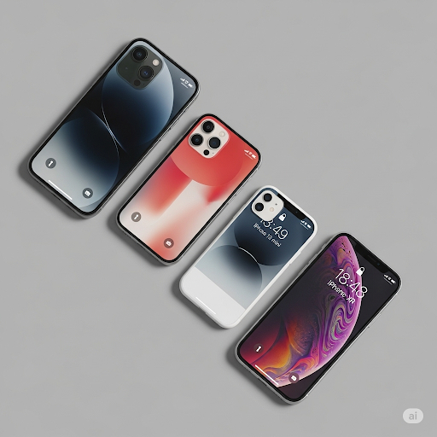
Objectives
As an Amazon Data Analyst, this project focuses on understanding customer sentiment surrounding the iPhone 15 128GB model. The core task involves conducting sentiment analysis on user-generated product reviews. By extracting and processing this textual data, the objective is to quantify and interpret overall public perception, categorizing it as positive or negative. The insights derived from this analysis are crucial for strategic decision-making, enabling Amazon to enhance the customer experience and identify specific areas where the product or associated services can be improved. This proactive approach aims to leverage customer feedback for tangible business benefits.

Slide 4
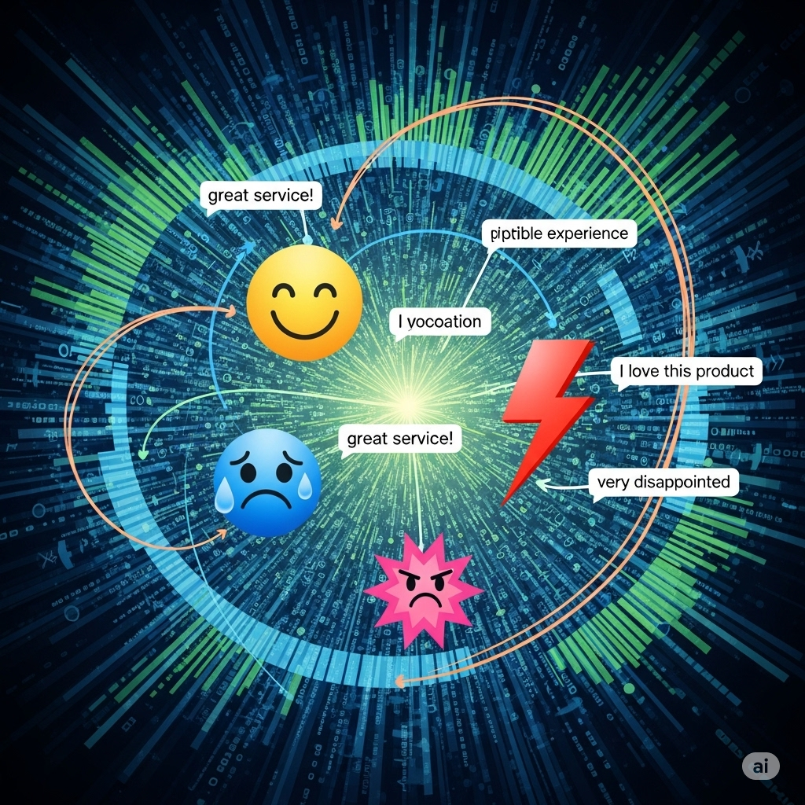
Procedures
Data Collection: Web scraping product reviews using Selenium (automation) and Beautiful Soup (HTML parsing).
Data Cleaning: Preprocessing raw data with Pandas for consistency and readiness.
Sentiment Analysis: Applying Text Blob to determine positive, negative, or neutral sentiment from review text.
Data Analysis: Utilizing Pandas for in-depth insights from the processed sentiment data.
Reporting: Visualizing findings like sentiment distribution and word clouds using Matplotlib/Seaborn for clear communication.

Slide 5
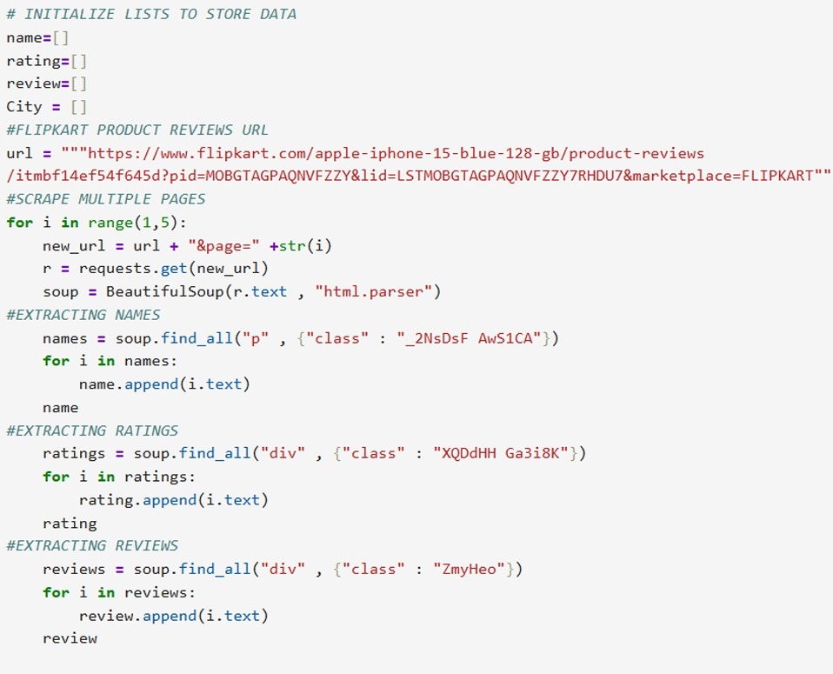
DATA CLEANING AND PREPROCESSING
**Pandas Data Cleaning for Analysis:**
1. **Deduplicate:** Eliminate duplicate reviews for data integrity.
2. **Handle Missing Data:** Address incomplete reviews (text/rating) by removing or filling missing values.
3. **Preprocess Text:** Convert reviews to lowercase, remove irrelevant characters, tokenize words, and remove common stop words for sentiment analysis readiness.

Slide 6

Data Collection
To precisely collect iPhone 15 128GB reviews, the process begins by configuring Selenium to programmatically control a web browser. This involves navigating directly to the specific product page on Flipkart. Once loaded, Selenium will simulate user interactions, such as scrolling down or clicking "Load More Reviews" buttons, to dynamically reveal all review content. Subsequently, Beautiful Soup will parse the HTML source code obtained by Selenium, meticulously extracting key details for each review: the user's name, their given rating, and the full review text. A critical aspect is implementing robust pagination handling, ensuring the scraper iterates through all available review pages to gather a comprehensive dataset.

Slide 7
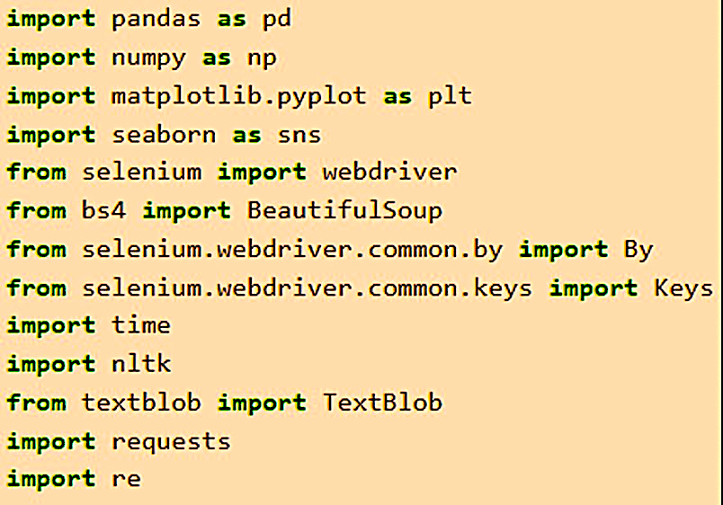
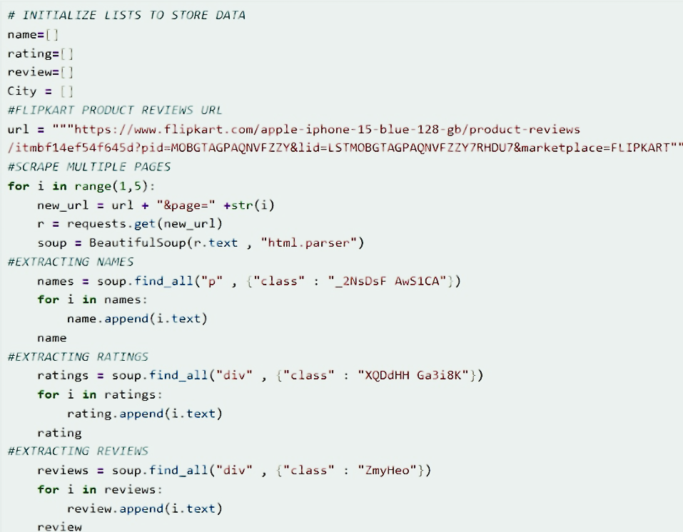

Slide 8
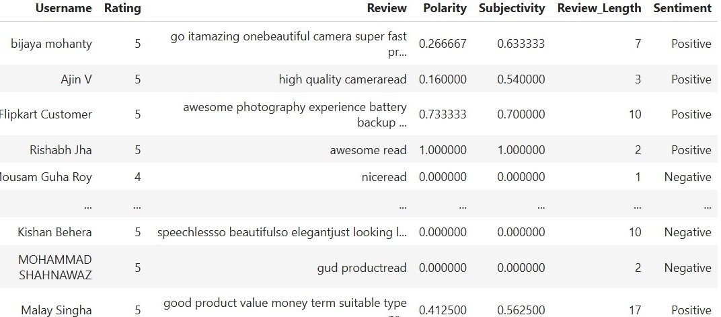
Customer reviews /Sentimental Analysis

Slide 9
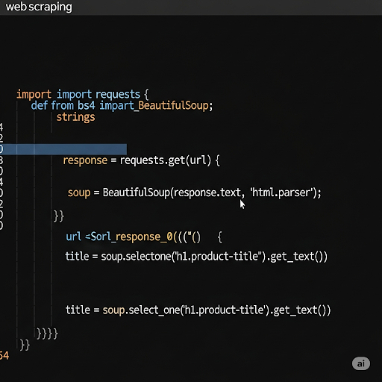
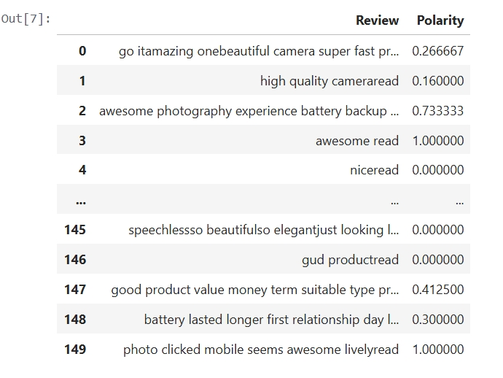

Slide 10
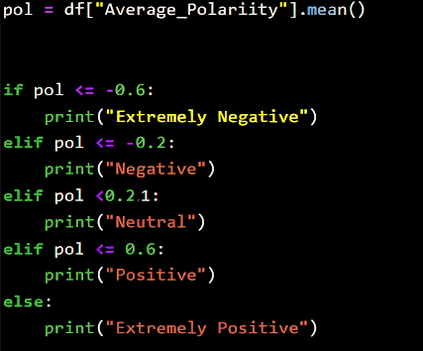

Slide 11

THANKING YOU PROJECT BY – SASANT
ALWAYS OPEN FOR YOUR WORDS
FEEL FREE TO CONNECT

